Slide 1

Breast Cancer
Group M：
Xu Jiaqi
Chen Tiantian

Slide 2

CONTENTS
01 About Data
02 Demonstration
03 Conclusion
04 Challenge

Slide 3
CONTENTS
01 文化知识概述
01 About Data
02 Demonstration
03 Conclusion
04 Challenge

Slide 4
Background
Breast cancer is the leading cause of cancer-related deaths in women worldwide.
Recurrence is the major cause of death with poor treatment efficacy.
Despite advances in early detection and comprehensive treatments for breast cancer, approximately 30% of patients with early-stage breast cancer still experience recurrent disease
Reference：
[1]Lukong, K. E., Y. Ogunbolude, et al. (2017). "Breast cancer in Africa: prevalence, treatment options, herbal medicines, and socioeconomic determinants." Breast Cancer Research and Treatment 166(2)
[2]P Priestley, J Baber, M Lolkema, N Steeg , et al. (2019). (2007). ‘Pan-cancer whole genome analyses of metastatic solid tumors’. bioRxiv
[3]Gonzalez-Angulo AM, Morales-Vasquez F, Hortobagyi GN. Overview of resistance to systemic therapy in patients with breast cancer. Adv Exp Med Biol.

Slide 5

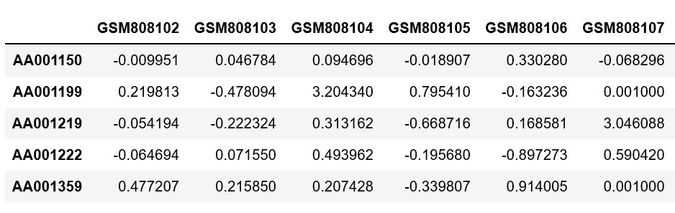
1.About Data
Data source and data structure
GEO database(https://www.ncbi.nlm.nih.gov/geo/query/acc.cgi?acc=GSE32603)
Research subject : 248 patients
Samples : 35069 gene expression profile of 248 breast cancer patients
What we want to research? / What our research aim is?
· We would like to find different expression gene(DEG) on the patients with breast cancer recurrence and non-breast cancer recurrence in this dataset.

Slide 6
CONTENTS
01 About Data
02 企业文化概述
02 Demonstration
03 Conclusion
04 Challenge

Slide 7
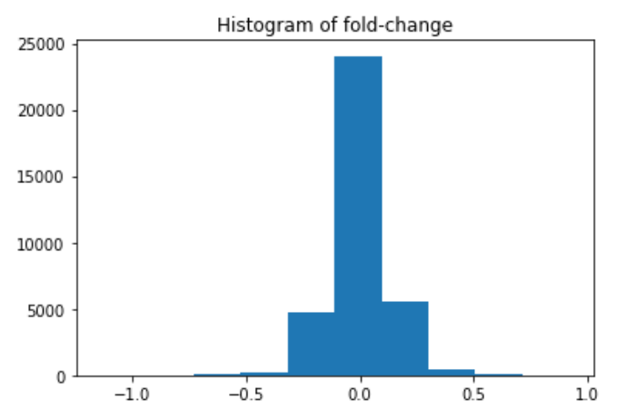
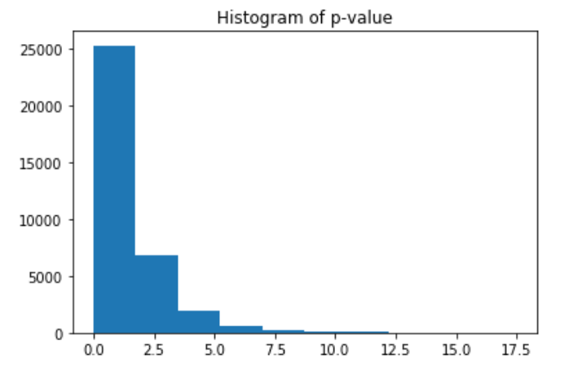
Demonstration
Distribution of fold-change and p-value of two groups

Slide 8
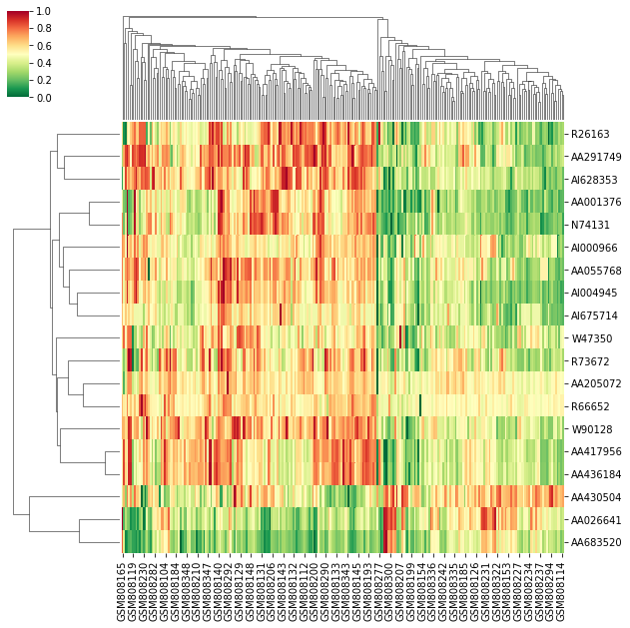
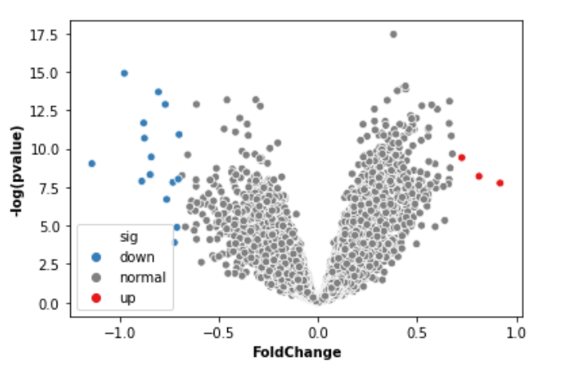
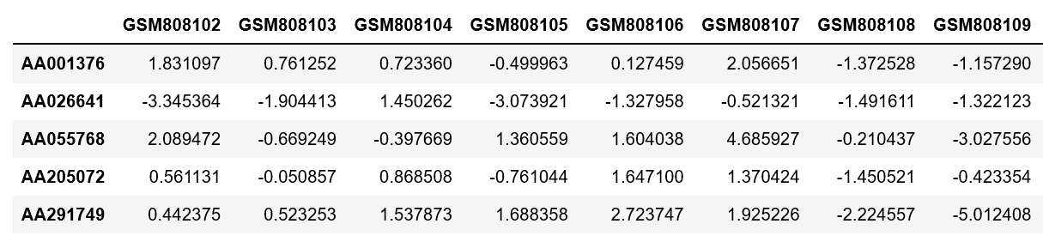
Demonstration
19 different gene expression between two groups

Slide 9
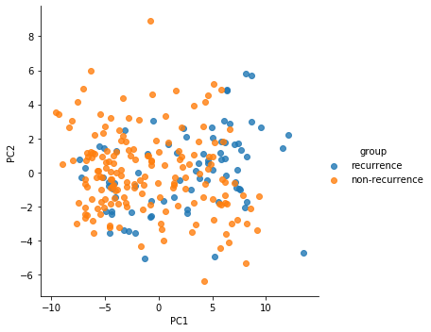
Demonstration
PCA analysis on two groups

Slide 10
CONTENTS
01 About Data
02 Demonstration
03 为啥要做文化
03 Conclusion
04 Challenge

Slide 11
Conclusion
From this dataset we focus on the patients with and without breast cancer recurrence;
We tried to find the different expression gene(DEG) between breast cancer recurrence and non-recurrence patients;
We found 19 DEG between these two groups;
For further research, we can annotate these genes and find the related pathways, trying to explain breast cancer recurrence on gene level.

Slide 12
CONTENTS
01 About Data
02 Demonstration
03 Conclusion
04 需要何种文化
04 Challenge

Slide 13
Challenge
Finding the right data to match pre-defined research topics.
Hard to find the suitable data for analysis.
Research results may not meet hypothesis.

Slide 14

Thanks for listening!

